Slide 1

+
Input and Output System

Slide 2

⁺ Introduction to I/O Module
An I/O module is not simply a set of mechanical connectors that wire a device into the system bus. Rather, the I/O module contains logic for performing a communication function between the peripheral and the bus.
why one does not connect peripherals directly to the system bus. The reasons are as follows:
There are a wide variety of peripherals with various methods of operation. It would be impractical to incorporate the necessary logic within the processor to control a range of devices.
The data transfer rate of peripherals is often much slower than that of the memory or processor. Thus, it is impractical to use the high-speed system bus to communicate directly with a peripheral.
On the other hand, the data transfer rate of some peripherals is faster than that of the memory
or processor. Again, the mismatch would lead to inefficiencies if not managed properly.
Peripherals often use different data formats and word lengths than the computer to which they are attached.

Slide 3

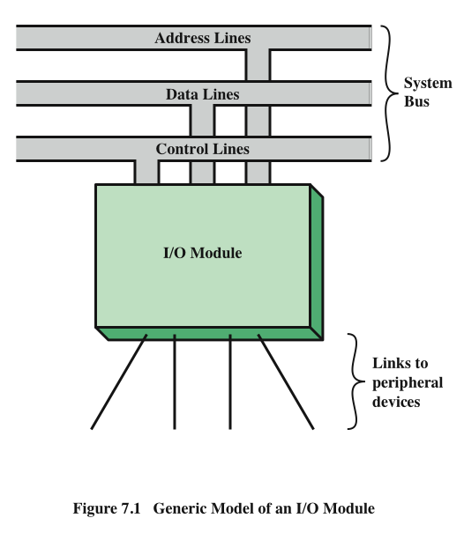




+
Generic Model of an I/O Module

Slide 4


⁺ External Devices
Provide a means of exchanging data between the external environment and the computer
Attach to the computer by a
link to an I/O module
The link is used to exchange control, status, and data between the I/O module and the external device
peripheral device
An external device connected to an I/O module
Three categories:
Human readable
Suitable for communicating with the computer user
Video display terminals (VDTs), printers
Machine readable
Suitable for communicating with equipment
Magnetic disk and tape systems, sensors and actuators
Communication
Suitable for communicating with remote devices such as a terminal, a machine readable device, or another computer

Slide 5

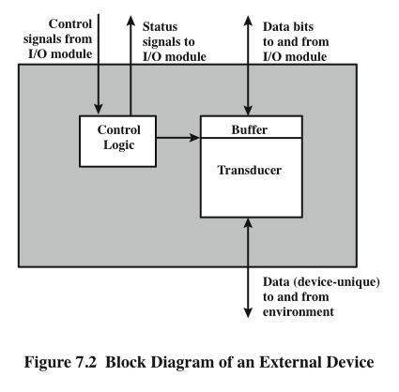




+
External Device Block Diagram

Slide 6

+
Most common means of
computer/user interaction
User provides input through the keyboard
The monitor displays data provided by the computer
Keyboard/Monitor
International Reference Alphabet (IRA)
◼ Basic unit of exchange is the character
◼ Associated with each character is a
code
Keyboard Codes
When the user depresses a key it generates an electronic signal that is interpreted by the transducer in the keyboard and translated into the bit pattern of the corresponding IRA code
This bit pattern is transmitted to the I/O module in the computer
◼ Each character in this code is represented by a unique 7-bit binary code
◼ 128 different characters can be represented
Characters are of two types:
Printable
Alphabetic, numeric, and special characters that can be printed on paper or displayed on a screen
Control
Have to do with controlling the
printing or displaying of characters
Example is carriage return
◼ On output, IRA code characters are transmitted to an external device from the I/O module
◼ The transducer interprets the code and sends the required electronic signals to the output device either to display the indicated character or perform the requested control function

Slide 7


































































I/O Modules
Control and timing
Coordinates the flow of traffic between internal resources and external devices
Module Function
Processor
communication
Involves command decoding, data, status reporting, address recognition
Error detection
Detects and reports transmission errors
The major functions for an I/O module fall into the following categories:
Data buffering
Performs the needed buffering operation to balance device and memory speeds
Device communication
Involves commands, status information, and data

Slide 8

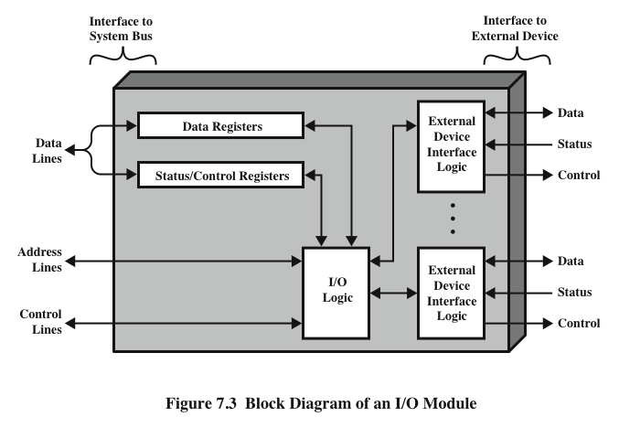
I/O Module Structure

Slide 9

I/O operations
+
Three techniques are possible for I/O operations:
Programmed I/O
Data are exchanged between the processor and the I/O module
Processor executes a program that gives it direct control of the I/O operation
When the processor issues a command it must wait until the I/O operation is complete
If the processor is faster than the I/O module this is wasteful of processor time
Interrupt-driven I/O
Processor issues an I/O command, continues to execute other instructions, and is interrupted by the I/O module when the latter has completed its work
Direct memory access (DMA)
The I/O module and main memory exchange data directly without processor involvement

Slide 10



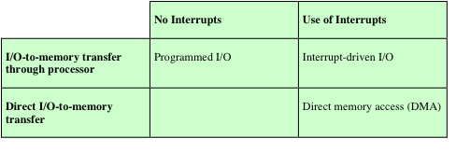
Table 7.1 I/O Techniques
+

Slide 11

⁺ Overview of Programmed I/O
◼When the processor is executing a program and encounters an instruction related to I/O, It executes that instruction by issuing a command to the appropriate I/O module.
◼ With programmed I/O, the I/O module will perform the requested action and then set the appropriate bits in I/O status register.

Slide 12


I/O Commands
+
There are four types of I/O commands that an I/O module may
receive when it is addressed by a processor:
Control
used to activate a peripheral and tell it what to do
Test
used to test various status conditions associated with an I/O
module and its peripherals
Read
causes the I/O module to obtain an item of data from the peripheral and place it in an internal buffer
Write
causes the I/O module to take an item of data from the data bus and subsequently transmit that data item to the peripheral

Slide 13

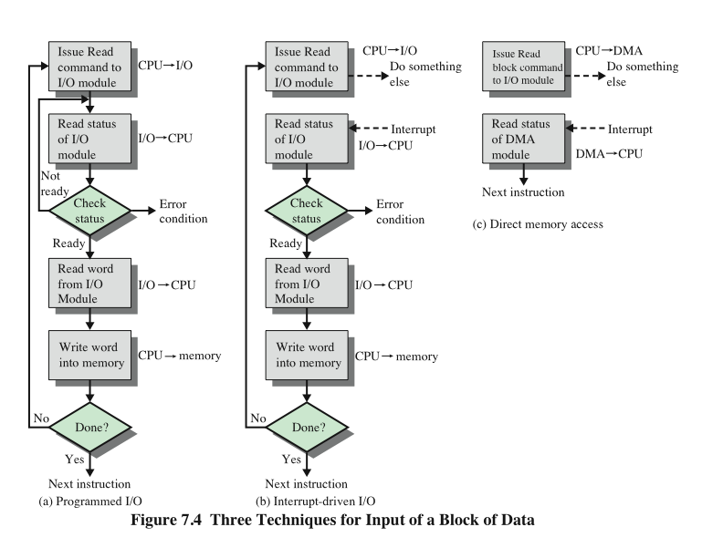




Three Techniques for Input of a Block of Data

Slide 14

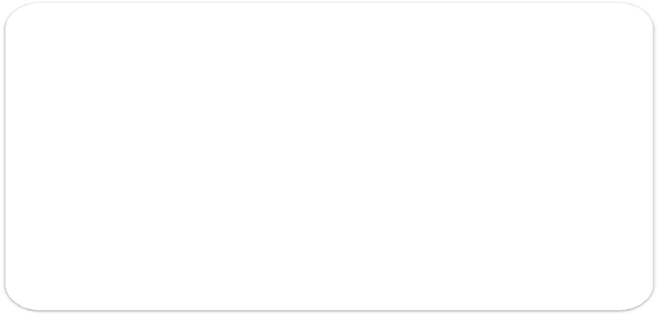



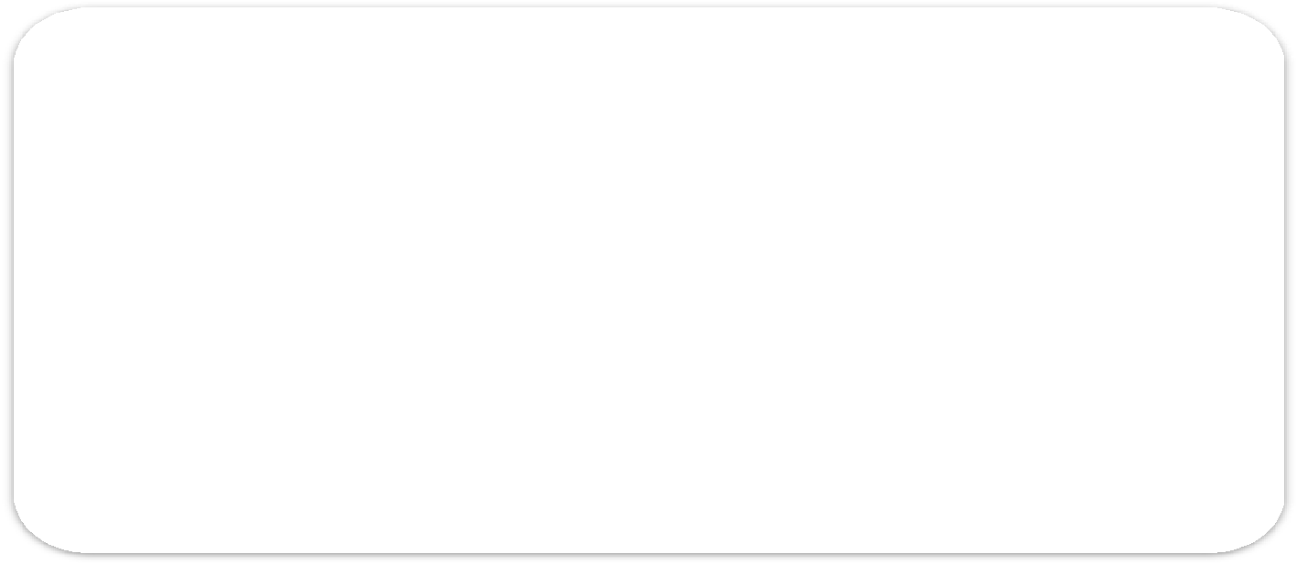




























I/O Instructions
With programmed I/O there is a close correspondence between the I/O-related instructions that the processor fetches from memory and the I/O commands that the processor issues to an I/O module to execute the instructions
Each I/O device connected through I/O modules is given a unique identifier or address
The form of the instruction depends on the way in which external devices are addressed
When the processor issues an I/O command, the command contains the address of the desired device
Memory-mapped I/O
Thus each I/O module must interpret the address lines to determine if the command is for itself
There is a single address space for memory locations and I/O devices
A single read line and a single write line are needed on the bus

Slide 15
















Interrupt-Driven I/O
The problem with programmed I/O is that the processor has to wait a long time for the I/O module to be ready for either reception or transmission of data
An alternative is for the processor to issue an I/O command to a module and then go on to do some other useful work
The I/O module will then interrupt the processor to request service when it is ready to exchange data with the processor
The processor executes the data transfer and resumes its former processing

Slide 16




Design Issues
Because there will be multiple I/O modules how does the processor determine which device issued the interrupt?
Two design issues arise in implementing interrupt I/O:
If multiple interrupts have occurred how does the processor decide which one to process?

Slide 17





Drawbacks of Programmed and Interrupt-Driven I/O
Both forms of I/O suffer from two inherent
drawbacks:
The I/O transfer rate is limited by the speed with which the processor can test and service a device
The processor is tied up in managing an I/O transfer; a number of instructions must be executed for each I/O transfer
+
◼ When large volumes of data are to be moved a more efficient technique is direct memory access (DMA)

Slide 18

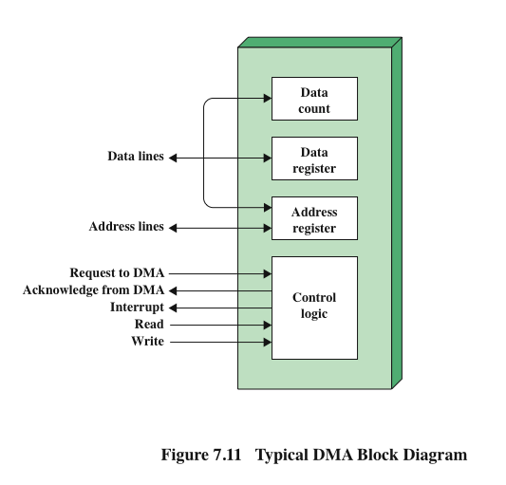


+
Typical DMA Module Diagram

Slide 19

DMA Controller is a hardware device that allows I/O devices to directly access memory with less participation of the processor.
DMA controller needs the same old circuits of an interface to communicate with the CPU and Input/Output devices.
The DMA controller has three registers as follows.
Address register – It contains the address to specify the desired location in memory.
Word count register – It contains the number of words to be transferred.
Control register – It specifies the transfer mode.
The CPU initializes the DMA by sending the given information through the data bus.
The starting address of the memory block where the data is available
(to read) or where data are to be stored (to write).
It also sends word count which is the number of words in the memory block to be read or write.
Control to define the mode of transfer such as read or write.
A control to begin the DMA transfer.

Slide 20

⁺ Memory Mapped I/O
In memory mapping of I/O devices, the I/O ports are assigned 16-bit address within the memory.
Here each bus is common thus the same set of instructions is used for memory and I/O devices. Thus, I/O is considered as memory and the same address space is used by both memory and I/O devices. This reduces the addressing capability of the memory.
In this case, the processor considers the I/O ports as memory locations for the purpose of reading and writing. So, whenever, an address is generated on the address bus then resultantly control signal is generated for memory read.
In such a case, the processor is not concerned whether the responding data is coming from a memory device or an I/O device. The same is the case with the memory write operation.

Slide 21

⁺ I/O Mapped I/O
It is also known as Isolated I/O mapping and the reason for the same is that here the address space of memory and I/O are separated from each other. Thus, different read and write instructions are used for I/O and memory.
In this approach, there is a common bus for I/O devices and memory however, individual read and write control lines are used for I/O.
Here the operation takes place in a way that, if the data over which operation is to be performed is to be collected from the I/O devices then address is placed on the address line and I/O read and I/O write control lines will get activated so that data transfer can be performed between the processor and I/O.
For the transfer of data between the processor and I/O devices, only IN and OUT instructions are used in the isolated mapping. The required chip select signals in this case are generated by an individual decoding unit.

Slide 22

₊ Difference between Memory
mapped I/O and I/O mapped I/O
Features | Memory Mapped IO | IO Mapped IO
Addressing | IO devices are accessed like any other memory location. | They cannot be accessed like any other location.
Address Size | They are assigned with 16-bit address values. | They are assigned with 8-bit address val
Instructions Used | The instruction used are LDA and STA, etc. | The instruction used are IN and OUT.
Cycles | Cycles involved during operation are Memory Read, Memory Write. | Cycles involved during operation are IO IO writes
Registers Communicating | Any register can communicate with the IO device | Only Accumulator can communicate wit devices
Space Involved | 2¹⁶ IO ports are possible to be used for interfacing in case of Memory Mapped IO. | Only 256 I/O ports are available for int case of IO Mapped IO.
Control Signal | No separate control signal required since we have unified memory space in the case of Memory Mapped IO. | Special control signals are used in the ca Mapped IO.

